Slide 1
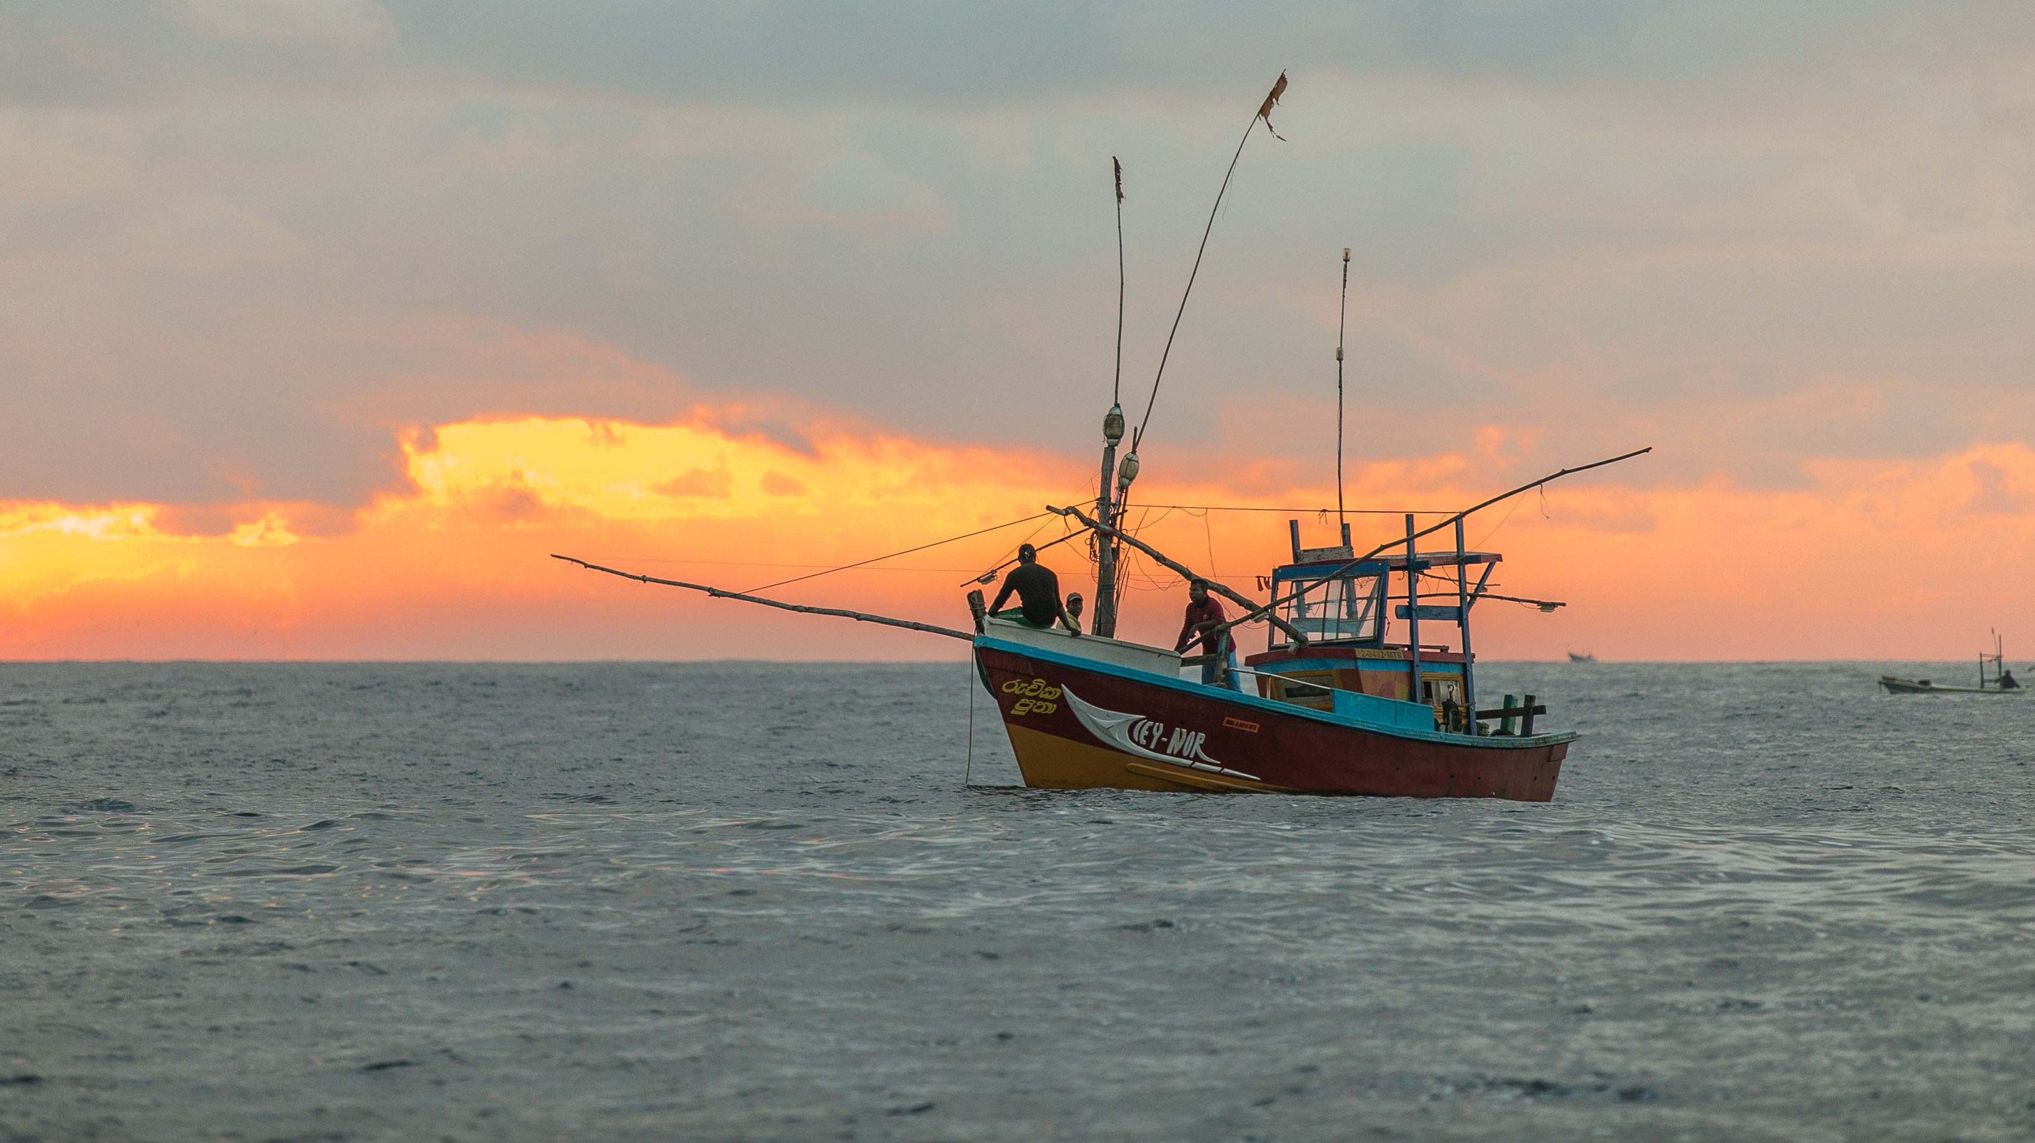
Global Fishing Watch Dataset – Which boat is fishing?
Metis Project 3
By Ouyang Yingzhao
Photo by Egle Sidaraviciute on Unsplash

Slide 2
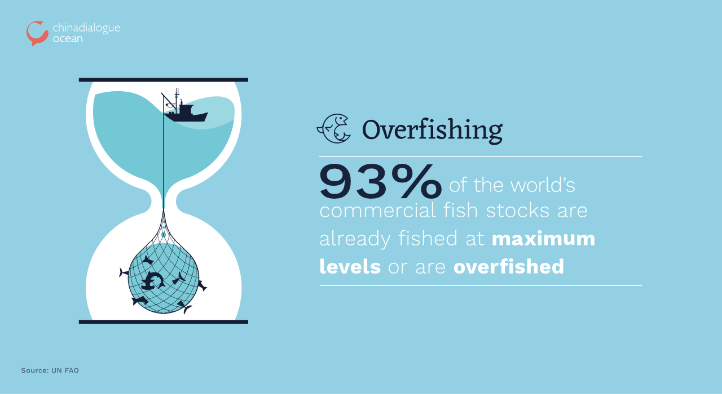

Slide 3
Objectives
Based on features derived from the Global Fishing Watch (GFW) dataset, predict which boat is fishing at any one time…
…to detect the presence of illegal fishing and/or overfishing

Slide 4





Methodology
Data retrieval
EDA
Visualisation
Model fitting and selection

Slide 5
Downloaded csv files from GFW
File | Number of records
drifting_longlines.csv | 13,968,727
unknown.csv | 6,811,552
trawlers.csv | 4,369,101
fixed_gear.csv | 1,559,137
purse_seines.csv | 1,545,323
trollers.csv | 166,243
pole_and_line.csv | 161,315
Focused on trawlers gear type
* As of 20 May 2020, csv files are no longer available, instead data is available on GFW’s Github in numpy format

Slide 6
Retrieved features
Feature(s) | Description
mmsi | Anonymised ID of the vessel
timestamp | Timestamp of the vessel’s report
distance_from_shore, distance_from_port | Generated by GFW
lat, lon, speed, course | Reported latitude, longitude, speed and course
is_fishing | 1 for yes, 0 for no -1 for no data Between 1 and 0 for no consensus
source | Source of the data
Dropped observations where:
Target is_fishing not present (-1) or ambiguous (between 1 and 0)
Missing data present (rare; usually in speed, course)
Target

Slide 7
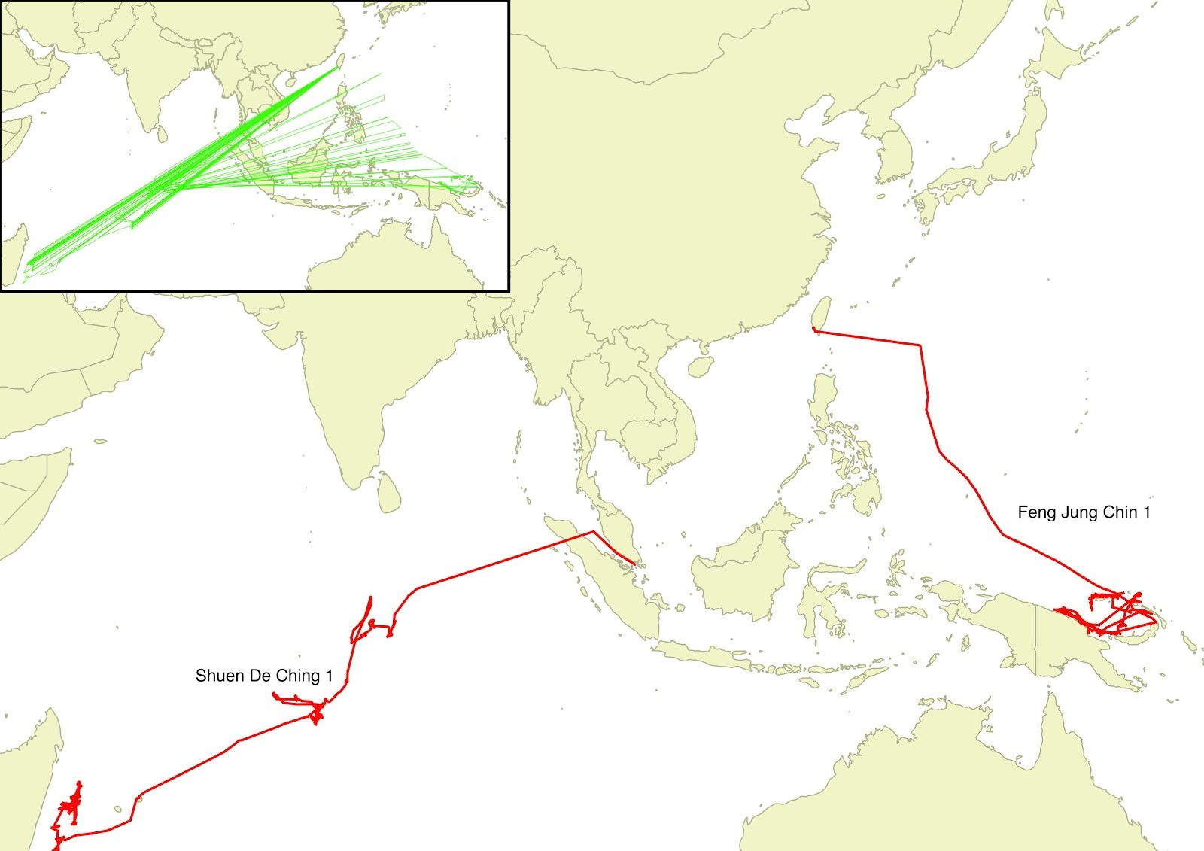
MMSI’s are not unique!
“… all throughout the oceans, multiple vessels are simultaneously broadcasting the same MMSI number, making them indistinguishable from one another without closer inspection.”
- Global Fishing Watch
Time-series patterns (e.g. previous values, moving averages) ignored for the purposes of this investigation
Example of two vessels broadcasting the same MMSI. Image credit: Global Fishing Watch

Slide 8
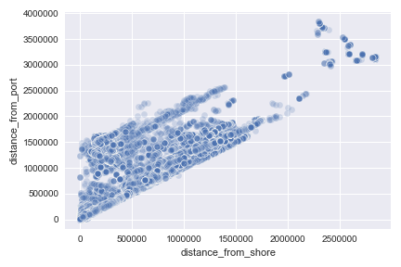
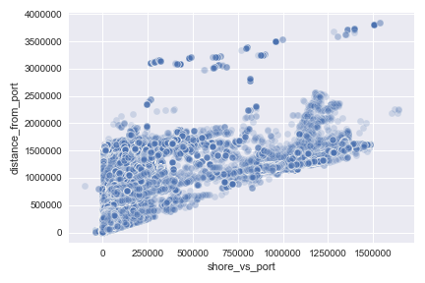
Distance from shore and distance from port are highly correlated!
Drop distance_from_shore as a feature

Slide 9
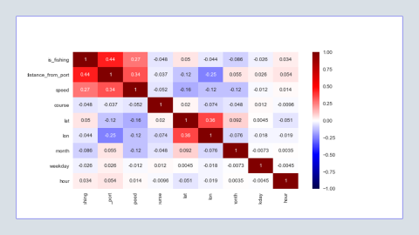
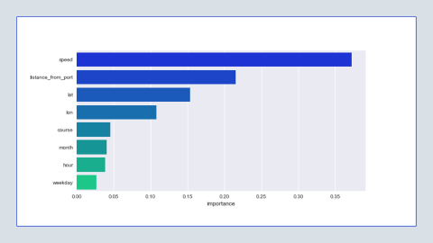
Feature selection
Random Forest feature importance
Generated from timestamp:
month, weekday, hour
From original features:
distance_from_port
lat, lon, speed, course
Total of 8 features
distance_from_port and speed appear to be the most important features
Correlation matrix

Slide 10
Model fitting
Prepping the data
80/20 split of train/test data
5-fold cross-validation on train data
4 classification models considered
KNN (on 20% of training set)
Logistic Regression (scaled features)
Gaussian Naïve Bayes (scaled features)
Random Forest
Metrices
f1
AUC
AUC graph: CV data
AUC graph: test data

Slide 11
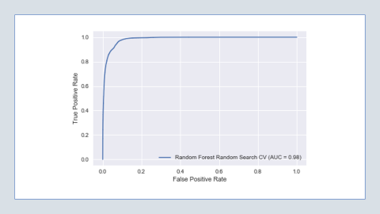
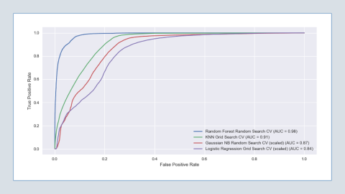
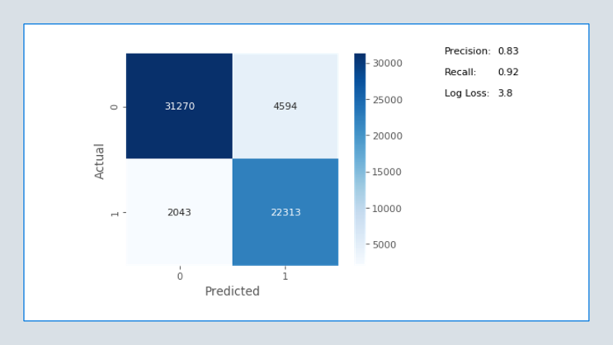

Model selection
AUC graph: CV data
Best performing is Random Forest
f1: 0.90 (both train and test)
AUC: 0.98 (both train and test)
AUC graph: test data
Click for hyperparameter tuning table for classification models

Slide 12
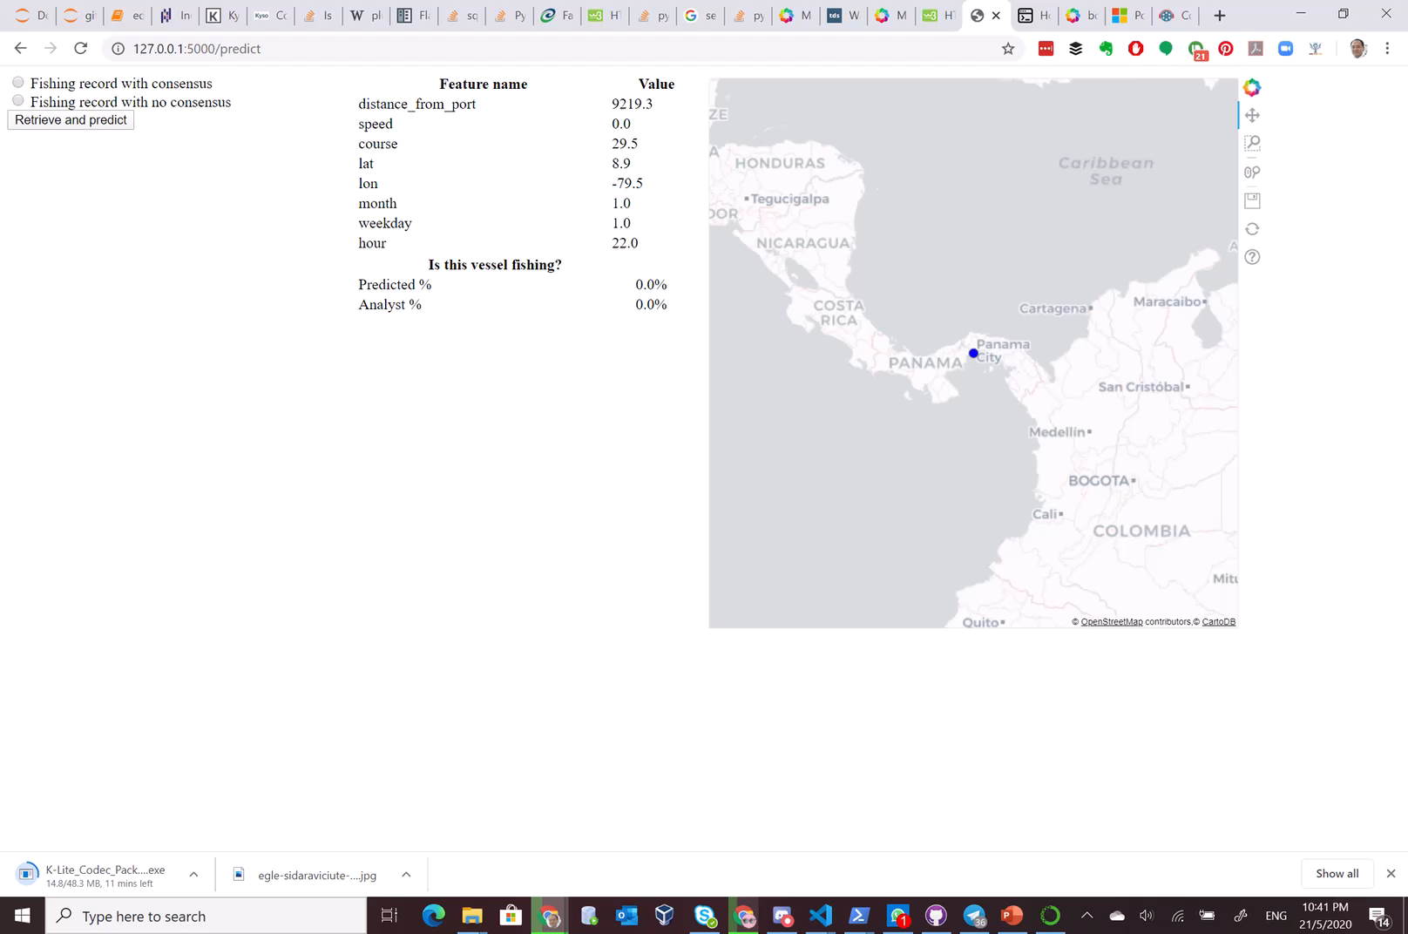


Test app!

Slide 13

We can use models to predict and analyze overfishing!
Photo by Ryan Moreno on Unsplash

Slide 14
Further work
Disentangle ships sharing the same MMSI to facilitate time-series analysis
Apply models on larger dataset with gear types other than trawlers
Further models to determine what gear type a ship is using, or whether the ship is a fishing vessel
Convert time, course data from numerical to grouped categorical

Slide 15
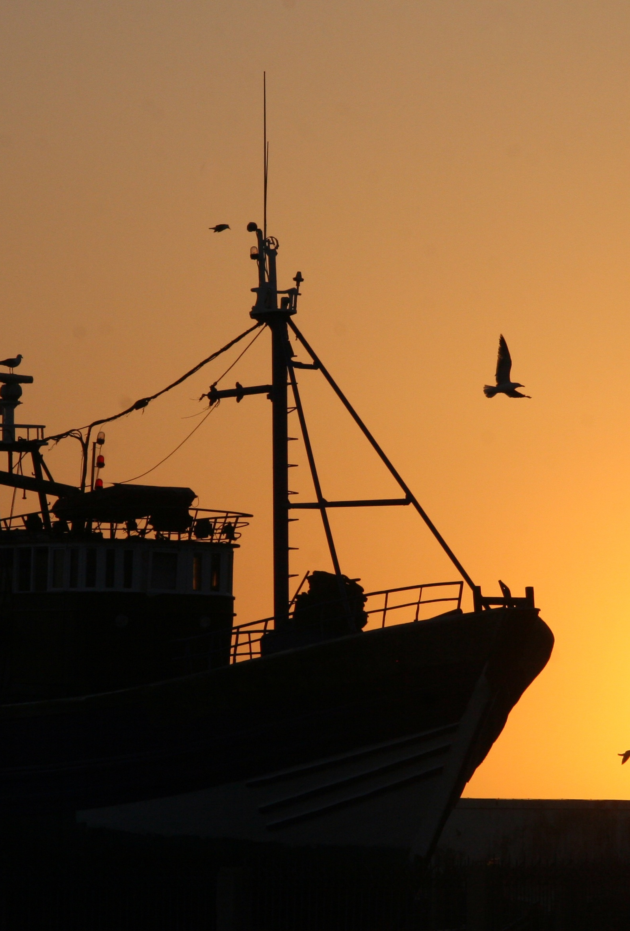

To contact me:
Yingzhao Ouyang
Data Scientist
https://www.linkedin.com/yzouyang
https://www.medium.com/@yzouyang
CC0 Public Domain from https://pxhere.com/en/photo/1331855

Slide 16

Appendix

Slide 17
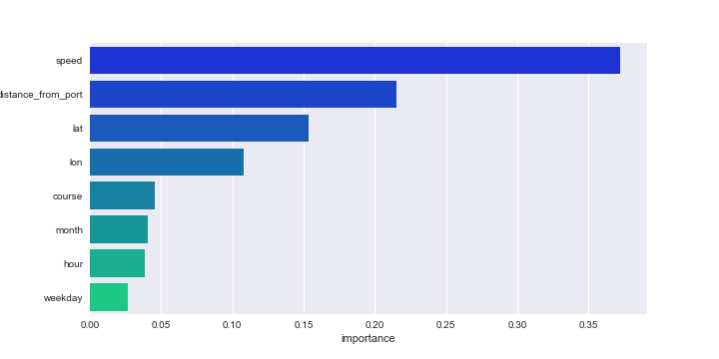

Slide 18
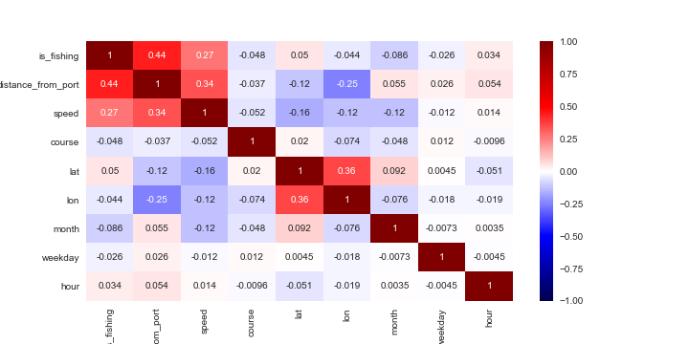

Slide 19
Details of models
Model | Hyperparameter fitting | Fitted hyperparameters | Notes | f1 score | AUC
Random Forest | Randomised search (20 iterations) | n_estimators [5, 10, 20, 40, 100] max_depth [5, 7, 10] min_samples_split [2, 3, 4] |  | 0.90 | 0.98
KNN | Grid search | n_neighbors [1, 2, … , 37, 38, 39] | Sampled 20% of training data | 0.85 | 0.91
Gaussian Naïve Bayes | N/A | N/A | Applied StandardScalar on training set features | 0.58 | 0.87
Logistic Regression | Randomised search (20 iterations) | penalty [l2, none] C [10-4, 10⁻³, … , 10⁴]* | Applied StandardScalar on training set features | 0.49 | 0.84
* Not applicable when penalty = none

Slide 20
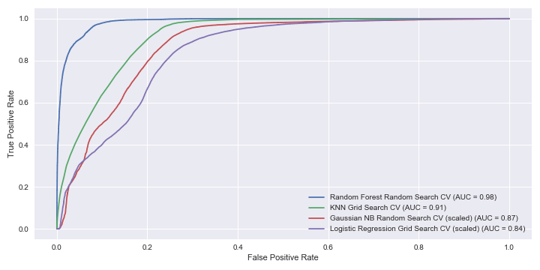

Slide 21
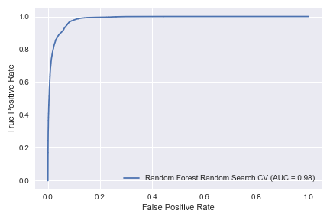

Slide 22
